Slide 1
Experiment
A repeatable procedure that produces potentially different outcomes at every trial
Set of all outcomes is the sample space
Events are sets of outcomes
Events are subsets of the sample space
Probabilities will be assigned to events

Slide 2

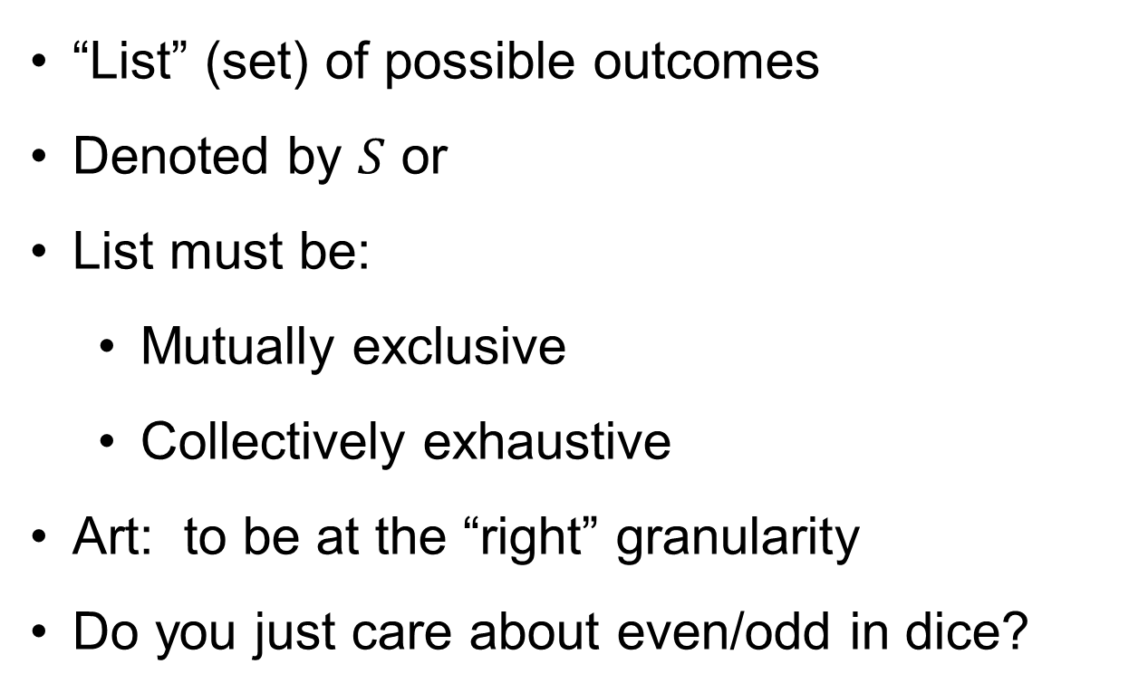
More on Sample Space
“List” (set) of possible outcomes
Denoted by $S$ or
List must be:
Mutually exclusive
Collectively exhaustive
Art: to be at the “right” granularity
Do you just care about even/odd in dice?

Slide 3
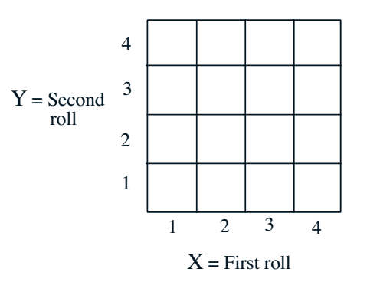
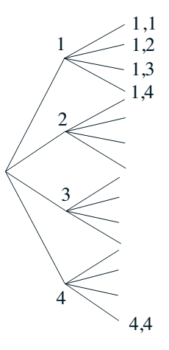
Sample Space: Discrete Example
Two rolls of a tetrahedral die
Sample space vs. sequential description

Slide 4
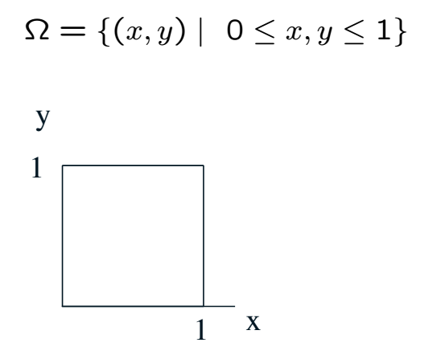
Sample Space: Continuous Example

Slide 5
Probability Space
Probability space consists of
Sample space
A collection of subsets of sample space called events
Probability assignments to each event
Events are subsets of sample space
Collection of events satisfy certain requrements
E.g. union of two events is an event; same with intersection
There are other technical requirements
How probabilities are assigned to events is subject to
rules (axioms)

Slide 6
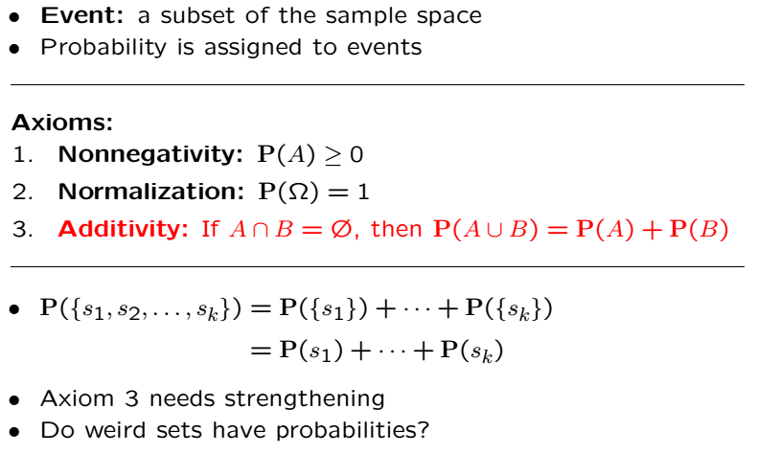
Axioms of Probability

Slide 7
Acknowledgements and Citations
Parts of these slides are adapted from the following resources:
Power Point Lecture Slides for the Textbook http://bcs.wiley.com/hebcs/Books?action=index&bcsId=8676&itemId=1118324560
John Tsitsiklis. 6.041 Probabilistic Systems Analysis and Applied Probability, Fall 2010. (Massachusetts Institute of Technology: MIT OpenCourseWare),http://ocw.mit.edu (Accessed 13 Apr, 2015). License: Creative Commons BY-NC-SA

